Slide 1
Streaming, transfer of rights, and management of large catalogues AN AUSTRIAN PERSPECTIVE OF music authors & COMPOSERS in the streaming age
Mag. Siegfried Samer, MBA
AKM & austro mechana
Head of Media
Notes:
Good morning ladies and gentlemen, my name is Siegfried Samer, I work for Austria‘s collective rights management societies for musical works, AKM and austro mechana, as the Head of its Media Department, and I would like to start my presentation about an Austrian perspective of music authors & composers in the streaming age with a REVELATION and an APOLOGY.
SLIDE CHANGE

Slide 2
Music authors, composers and publishers as rights holders
A THREEFOLD REVELATION
A SOCRATIC APOLOGY
Notes:
Let me start with the REVELATION, which is actually a threefold revelation.
The revelation came to me as I was traveling on the train to Opatija yesterday, and I had a lot of time on my hands.
Now having a lot of time on your hands is not always a good thing, as it gives you ample opportunity to THINK.
So I started thinking about my presentation, and this leads me to the FIRST REVELATION: I am not supposed to be here.
And I don’t mean this in a philosophical or existential way, but a purely factual one – I am here today in lieu of my esteemed colleague Paul Fischer, Head of AKM and austro mechana’s legal department, who unfortunately cannot be here today due to a scheduling conflict.
Now as I have been working for AKM and austro mechana for going on 15 years in the licensing field, in contrast to my colleague Paul, I consider myself more of a handyman in the context of copyright – as someone who is USING THE TOOLS given to him by people much smarter and more knowledgeable than he – the thinkers and wordsmiths who create our collective copyright legislation – AND THAT INCLUDES MANY OF YOU.
And this leads me to my SECOND REVELATION, that being: I am quite intimidated to be speaking here today, in this forum comprised of the brightest minds and leading experts in copyright.
And when this revelation hit me, I started panicking a little, thinking about what it is that someone like me could possibly teach such experts as yourselves about copyright, and this led me to the THIRD REVELATION: for the answer to that question is: NOTHING.
That’s right, I think I can teach you nothing new about copyright.
So upon having this very “SOCRACTIC” REVELATION, I then thought: If I can’t really tell you anything new about copyright, then WHAT IS IT that I could speak to you about?` And this leads me to the APOLOGY – and here I would like to apologize not only to our esteemed host Pierre, who has been very helpful to me in the preparation of this presentation, but also to the interpreters and translators working behind the scenes, as I had previously sent a version of this presentation to them, but the presentation you are seeing today differs considerably from this previous version.
So apologies for this inconvenience.
SLIDE CHANGE

Slide 3
Music authors, composers as rights holders
Authors & composers = core group of copyright rights holders
„Originators of copyright“
Notes:
But going back to our topic at hand and my SOCRACTIC REVELATION, SCIO NESCIO, I then figured: Well, I am working for a CMO, and when I thought about that, an image sprang to my mind: the image of being “IN THE TRENCHES”, in a fight.
And while this may sound a bit cynical and maybe even macabre in times when we are confronted with very real geopolitical strife on a daily basis, it was nonetheless the image I had in my head: being in the trenches, standing shoulder to shoulder with and fighting for the rights of those whose rights we as a CMO have been entrusted with: the authors and composers of musical works.
And it is these authors and composers of musical works who sit at the centre of many of the creative works we are talking about at this meeting, and who I therefore like to identify as the “ORIGINATORS OF COPYRIGHT”.
And I think this fact that we as CMOs have the unique opportunity to interact with those originators of copyright on a daily basis, and learn about their concerns, ideas and hopes.
And therefore I think the biggest strength for me in this short presentation would be to relay some of those concerns, ideas and hopes of our “originators of copyright”, specifically in the context of online streaming exploitation, to you here today.

Slide 4
KEYWORD 1: TRANSFER
Austrian law: Human authorship principle
No full transfer of copyright possible under Austrian law (‘principle of authorship’)
Austrian law distinguishes between exclusive licenses/rights transfers (‘Werknutzungsrecht’) and non-exclusive licenses (‘Werknutzungsbewilligung’)(§24 Austrian Copyright Act, ACA)
Non-exclusive licenses which have been granted prior to the grant of an exclusive license remain valid (§24 (2) ACA)
Notes:
So I would like to highlight three of the topics covered by the ALAI questionnaire from the perspective of our members, and try to place them in a streaming context.
And I would like to start with the first keyword: TRANSFER
Now without going into too much legal details – as I am sure most of you are very familiar with these – I would like to look at some select questions of rights transfers from the perspective of our members.
So while Austrian law does not permit a full transfer of copyrights, it does of course enable the issuance of licenses – either non-exclusive or exclusive licenses.

Slide 5
KEYWORD 1: TRANSFER
No legal limitation on scope of license grant or forms of exploitation
But: §24c ACA introduces ‘Purpose Transfer Principle’ – restrictive interpretation of the scope of a rights grant
§24c (2) ACA: written form as mandatory formal requirement for rights grants regarding hitherto unknown types of exploitation
§24c (2) ACA also provides for a right of revocation of previously granted license within 3 months upon notification of intended new form of exploitation
Revocation right cannot be waived in advance
Ultimately: Balance between freedom of the author to have control over their own rights and the ability of the CMO to effectively manage the rights they are entrusted with
Notes:
In this context, and especially with STREAMING being one of the “newer” types of exploitations, this leads me to highlight the question of the SCOPE of such licenses, and in particular the question of how to deal with HITHERTO UNKNOWN TYPES OF EXPLOITATION.
And here Article 24c Austrian Copyright Act introduced the “Purpose Transfer Principle” into Austrian law – and that means that generally a RESTRICTIVE INTERPRETATION should be applied when determining the scope of a specific license.
Additionally, in respect of UNKNOWN TYPES OF EXPLOITATION, Article 24c introduces a WRITTEN FORM REQUIREMENT, as well as a RIGHT OF REVOCATION of previously granted licenses within 3 months upon notification of an intended new exploitation; which can also NOT BE WAIVED in advance.

Slide 6
KEYWORD 2: FAIRNESS
Fair remuneration
§37b (2) ACA: author is entitled to fair and proportionate remuneration for rights grants/licenses for exploitations according to §§14-18a ACA
§37c (1) ACA: authors are entitled to an additional fair and proportionate remuneration, if the original remuneration later on appears as clearly inadequately low due to subsequent profits generated by the exploitation of the work (transposition of Art 20 of DIR(EU) 2019/790)
Notes:
Now this question of the scope of a rights transfer also ties into the SECOND KEYWORD, which I would name ‘FAIRNESS”.
At the end of the day, the goal of copyright is to ensure a “fair and proportionate” remuneration for rights holders such as authors and composers.
And we know that royalties generated from online streaming exploitation have on the one hand displaced physical and download sales, but at the same time also yield considerably lower monetary results.
Article 37c of the Austrian Copyright Act is one provision that can address this topic in recent history at least to a certain degree, as this provision entitles rights holders to an ADDITIONAL FAIR AND PROPORTIONATE remuneration if the original remuneration later on appears as obviously inadequately low.
In the context of the streaming environment, this can be potentially relevant in the audiovisual fields, notably in respect of BUY OUT-type contracts for musical works incorporated in film works or video games, the latter being a steadily growing and very important market, that has meanwhile overtaken the film industry, but still remains a very difficult market for rights holders to navigate.

Slide 7
KEYWORD 3: TRANSPARENCY
§28 ACSA: CMOs have to fulfil certain information obligations towards rights holders before concluding representation agreement (e.g. ability of right holder to still grant licenses for certain non-commercial purposes)
§41 ACSA: Transparency and reporting obligations for CMOs
Minimum reporting once per year
Reporting to contain sufficient data to monitor correct allocation and distribution of royalties
Must contain:
Contact details of rights holder
Revenues allocated to the rights holder & amounts distributed
By rights category/type of use
Period covered by the report (unless necessary data not available to CMO)
Deductions from revenues (e.g. administrative costs; social & cultural services etc.)
Revenues allocated but not yet distributed
AKM & austro mechana: distributions currently 4 x / year
Notes:
And finally, the THIRD KEYWORD I would like to address is TRANSPARENCY.
Now while there are legal obligations surrounding transparency for rights holders in Austrian law, notably the transparency and reporting obligations for CMOs in Article 41 Austrian Copyright Act, those obligations are certainly being fulfilled by most CMOs – and I would like to show you as an example an excerpt from an actual AKM distribution, relating to online streaming – namely my own.

Slide 8
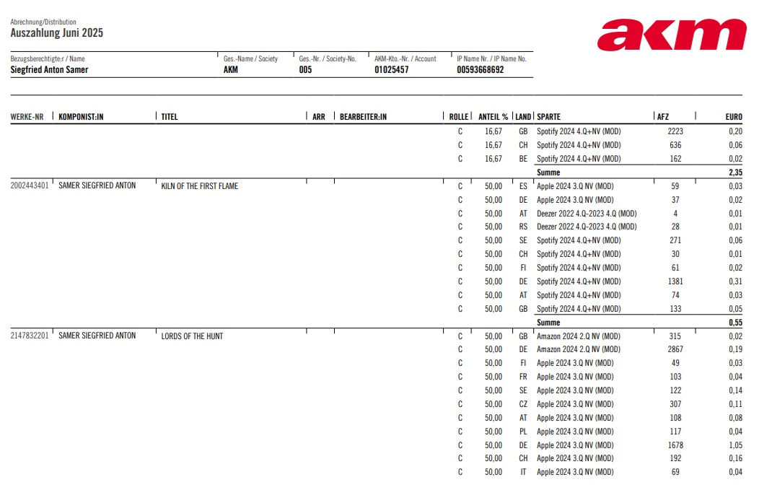
Keyword 3: Transparency
Sample distribution from AKM for streaming usage:
Notes:
On this screenshot you can see that AKM fulfils the transparency obligations by displaying information such as the right holder name, the title and work number of each individual work, the role the rights holder has in that work (in this case “C” for composer), the territory of exploitation, the exact number of usages reported and distributed, and of course the monetary amount distributed.
On a side note, In my particular case, this very opulent monetary amount also explains why I am here on a stage TALKING about my music as opposed to being on a stage actually PERFORMING my music, but that is the topic for another day.
However, I would like to pose the question of whether these TRANSPARENCY obligations should really be directed as CMOs, since at the end of the day, my feeling is that CMOs and rights holders are, as said, “in the trenches” together and fighting for the same goal.

Slide 9
KEYWORD 3: TRANSPARENCY
Real question: Transparency obligations not directed at CMOs, but at DSPs instead?
DSPs as those who exploit rights often influence, if not outright determine, matters of transparency and royalty distribution by the mere fact that they control the data:
Only DSPs know the extent of the catalogue made available by them
DSPs ‘see everything’ when it comes to streaming numbers, demographics, user behaviour etc
DSPs often obscure this information or share only parts of it with the rights holders
DSPs actively influence royalty distribution, e.g. by introducing new payout models:
User-Centric Models
Artist-Centric Models (e.g. Deezer, Soundcloud)
Question: Should it really be in the hands of the DSP as the exploiter of rights to determine the transparency and calculation of royalty distributions?
Notes:
Should it therefore not rather be the DSPs in the streaming environment, those who actually exploit the rights and should pay the fair and proportionate remuneration, to be subjected to stronger transparency obligations?
I am asking this because DSPs not only influence, but frequently even determine, the way royalties for rights holders are calculated and distributed, as it is only the DSPs who truly are the “MASTERS OF THE DATA” and who “see and hear everything”.
DSPs know the extent of the catalogue made available by them; they have all the interesting data such as streaming numbers, revenues generated, demographics, user behaviour etc., and they control the TRANSPARENCY of that data versus rights holders: CMOs, Labels, Publishers and authors and composers alike.
And finally, they actively influence royalty distribution by introducing different distribution models – from the “classic” PRO RATA MODEL to newer alternative models such as USER CENTRIC or even ARTIST CENTRIC MODELs, where in the case of ARTIST CENTRIC MODELS, DSPs introduce higher-value payouts for certain artist groups (e.g. “professional” artists) and parameters by which to determine membership in some groups, and subsequently distribute higher amounts to such artists.
So in closing, I would like to ask this question: no matter your position on such alternative royalty allocation methods, should it really be the USERS of the rights who determine these rules, instead of the RIGHTS HOLDERS?

Slide 10
Topics for discussion
INCREASING VISIBILITY FOR AUTHORS?
Putting a larger spotlight on creators ‘behind’ recorded music
Legal obligations for DSPs to provide correct songwriter credits, both in metadata & outward presentation?
ENSURING ADEQUATE & FAIR REMUNERATION?
Addressing imbalance of remuneration between songwriters & master rights holders
Stronger involvement of CMOs in fields that have traditionally been dominated by “Buy Out” contracts
Improving metadata quality to ensure better matching rates
Regulating DSP involvement in determination of royalty allocation and distribution
Regulation of transparency obligations of DSPs?
DEALING WITH AI IN THE MUSIC INDUSTRY?
Establishing working legal framework to ensure adequate compensation for use of musical works in training of AI / licensing AI output and subsequent use
Finding workable solutions to identify musical works used in AI content generation and apply in the context of AI content on streaming platforms
Legal obligations for DSPs to address AI content on their platforms, e.g. different distribution rules/per stream values for AI content
Notes:
So I would like to leave you with these additional possible topics for discussion, and hope that following our panel and the entire event today, I will be able to return home not with a SOCRATIC, but with a, let’s say, POST-SOCRATIC REVELATION that I might, after all, “KNOW SOMETHING”.
Thank you very much

Slide 11
Streaming, transfer of rights, and management of large catalogues AN AUSTRIAN PERSPECTIVE OF music authors & COMPOSERS in the streaming age
Mag. Siegfried Samer, MBA
AKM & austro mechana
Head of Media

